Slide 1

CSE 351: Titanic Data Science Project
By Dolly Trivedi

Slide 2
Cleaning the Data
To fill in missing non-numerical/categorical data, I found the most common value in each of those columns and replaced the blank cells with those values.
To fill in missing numerical data, I found the mean of each of those columns and replaced the blank cells with those means.
To get rid of the numerical outliers, I found the absolute value of the z-score for each of those columns and got rid of the rows that had z-scores greater than 3.

Slide 3
Visualizations

Slide 4
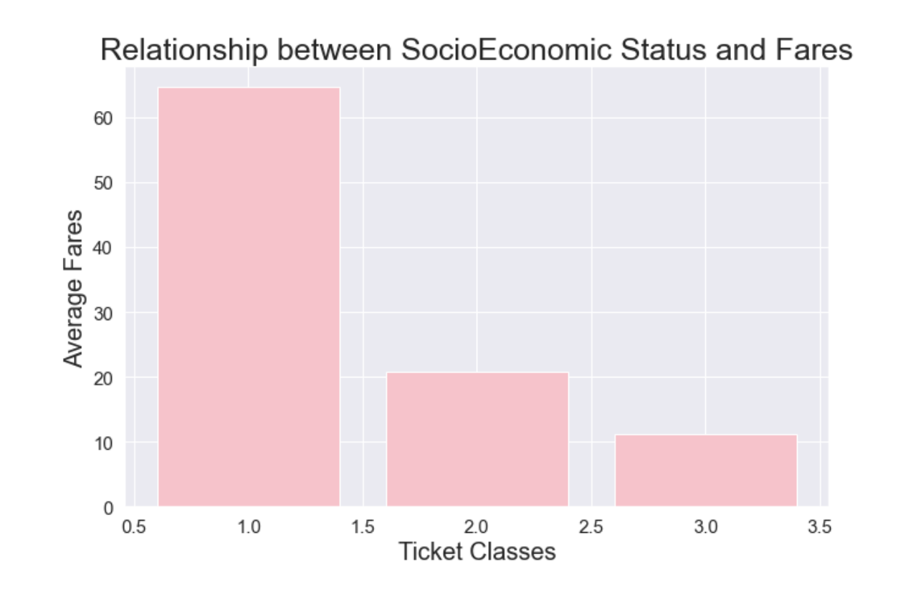
The bar chart shows that on average, first class tickets cost more than second class tickets. Additionally, on average, second class tickets cost more than third class tickets.

Slide 5
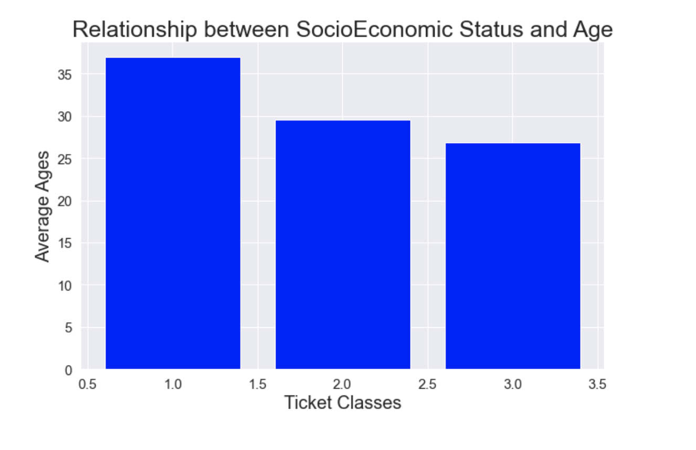
The bar chart shows that as the ticket classes increase (from 1 to 3), the average age decreases. This depicts that older people have greater incomes than younger people.

Slide 6
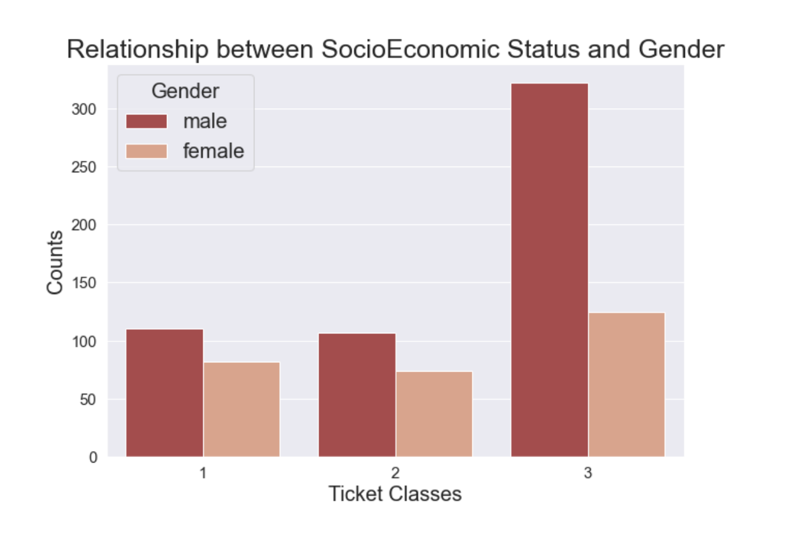
The grouped bar chart shows that males on the titanic had higher socioeconomic statuses than females.

Slide 7
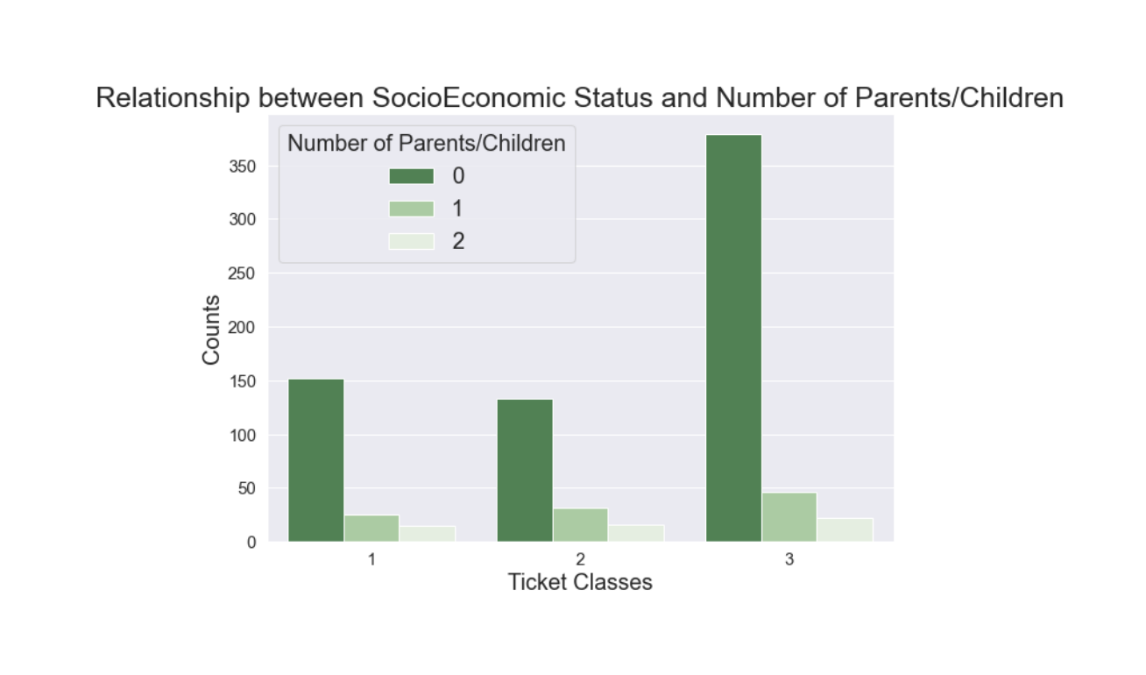
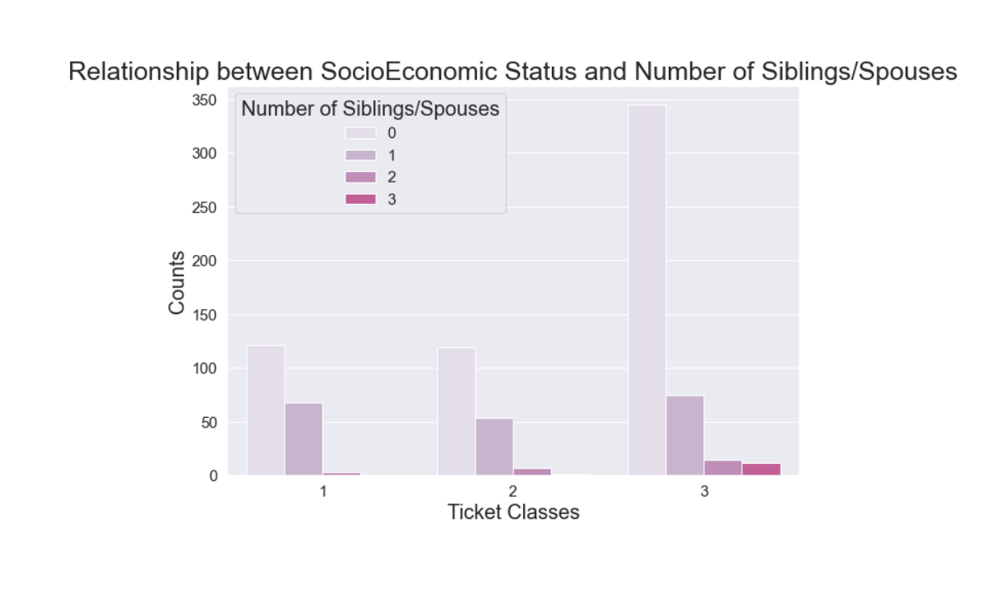
The grouped bar charts show that people who did not travel with their families generally had higher socioeconomic statuses than people who travelled with their children/parents/siblings/spouses.

Slide 8
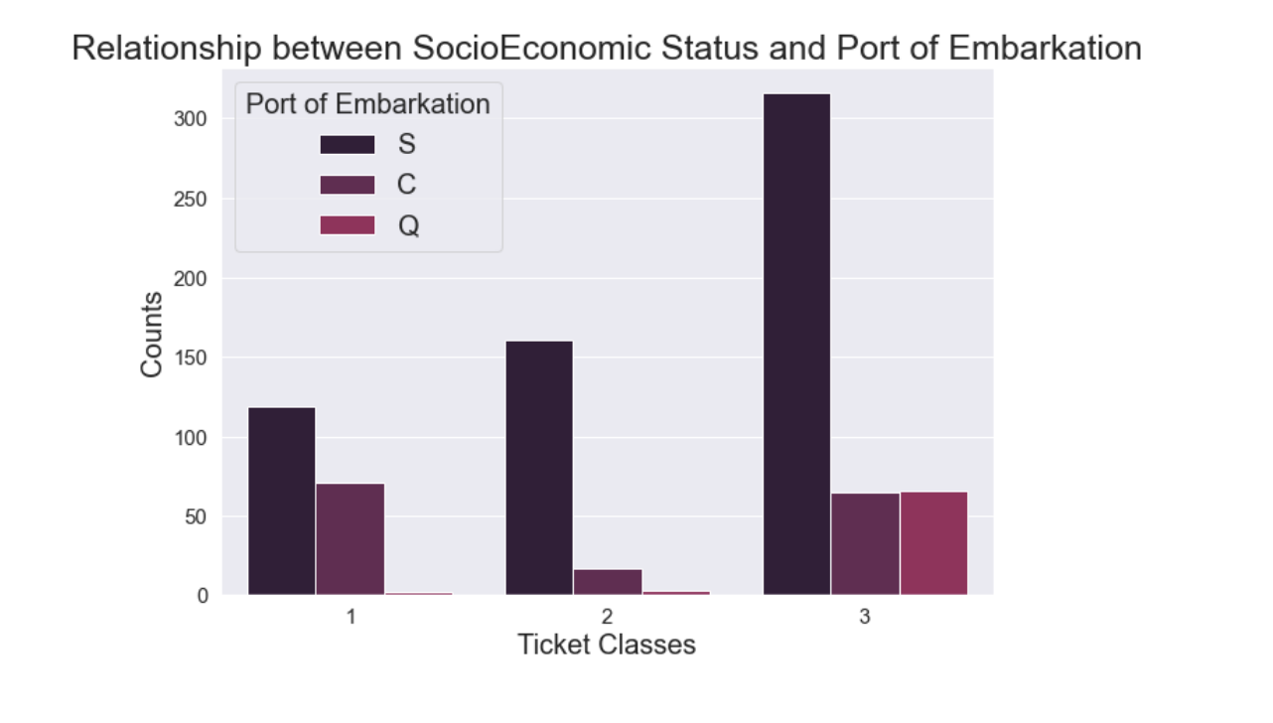
The grouped bar chart shows that people who were travelling from Southampton were richer than people who were travelling from Cherbourg and Queenstown.

Slide 9
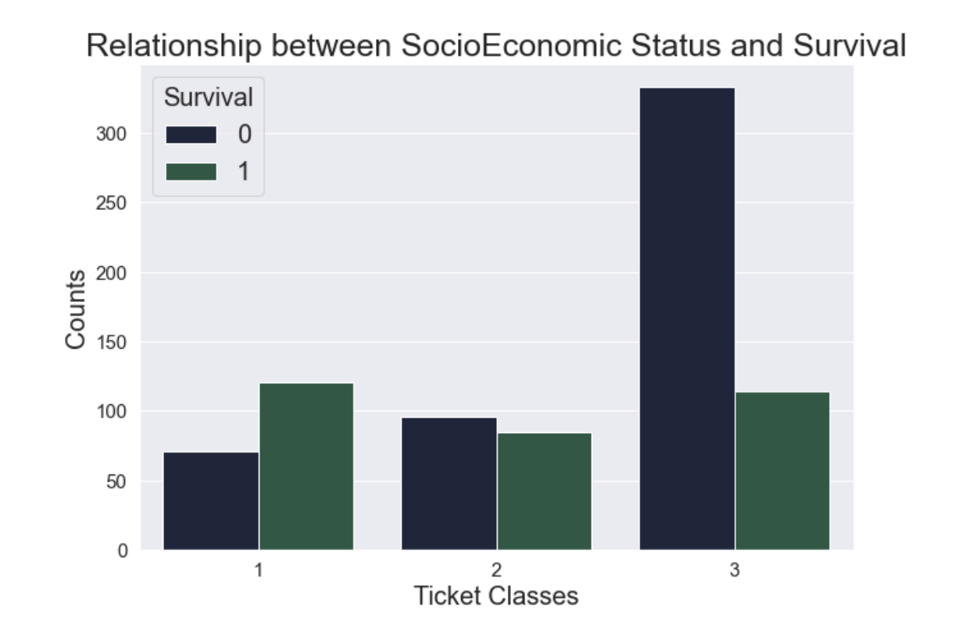
The grouped bar chart shows that more people with lower socioeconomic statuses did not survive.

Slide 10
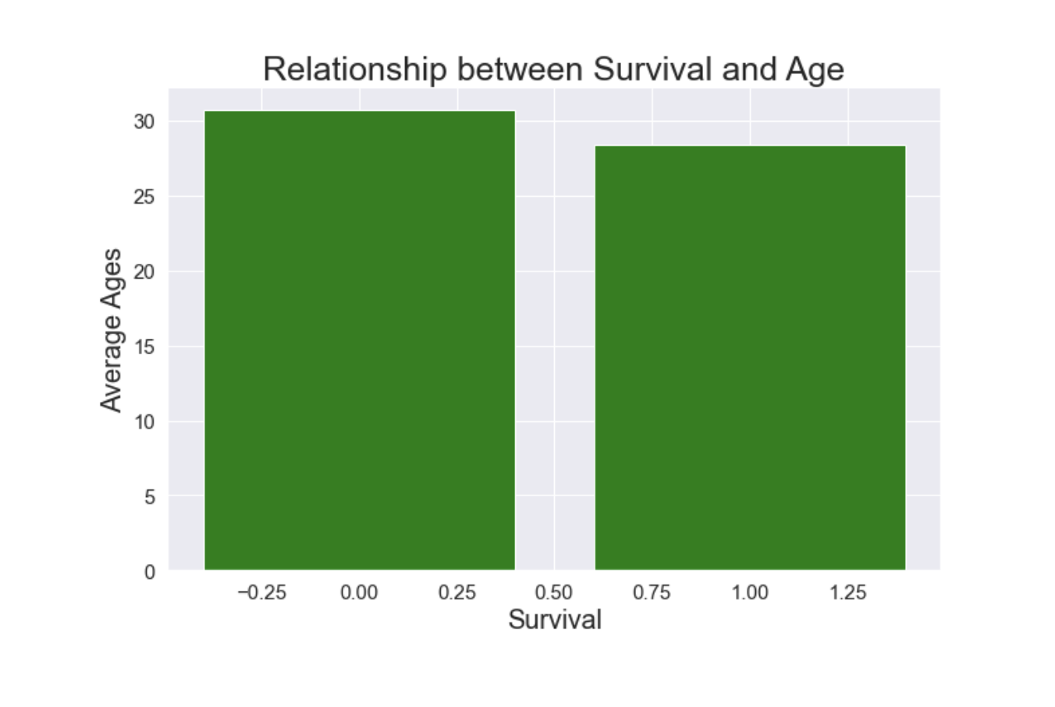
The bar chart shows that on average, people who did not survive were older by a slight amount than the people who survived.

Slide 11
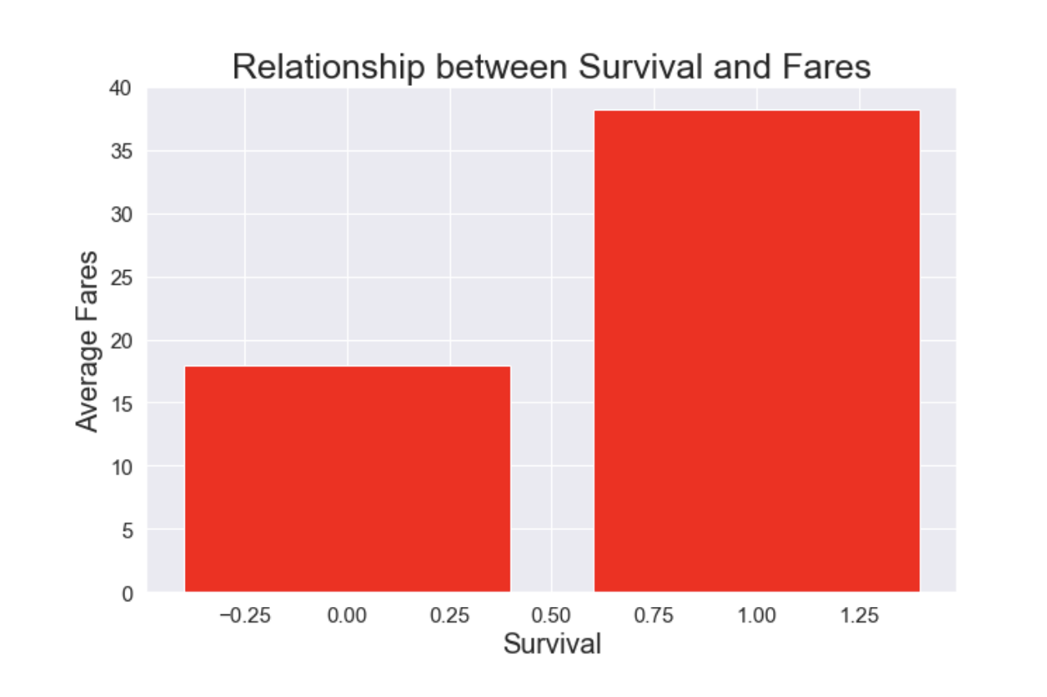
The bar chart shows that on average, people who survived paid more for their tickets than people who did not survive.

Slide 12
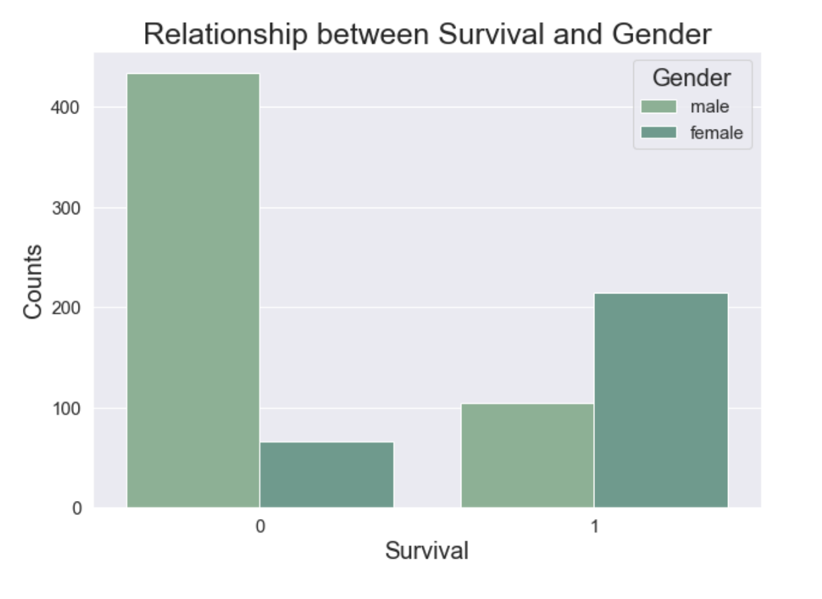
The grouped bar chart shows that more males did not survive than females.

Slide 13
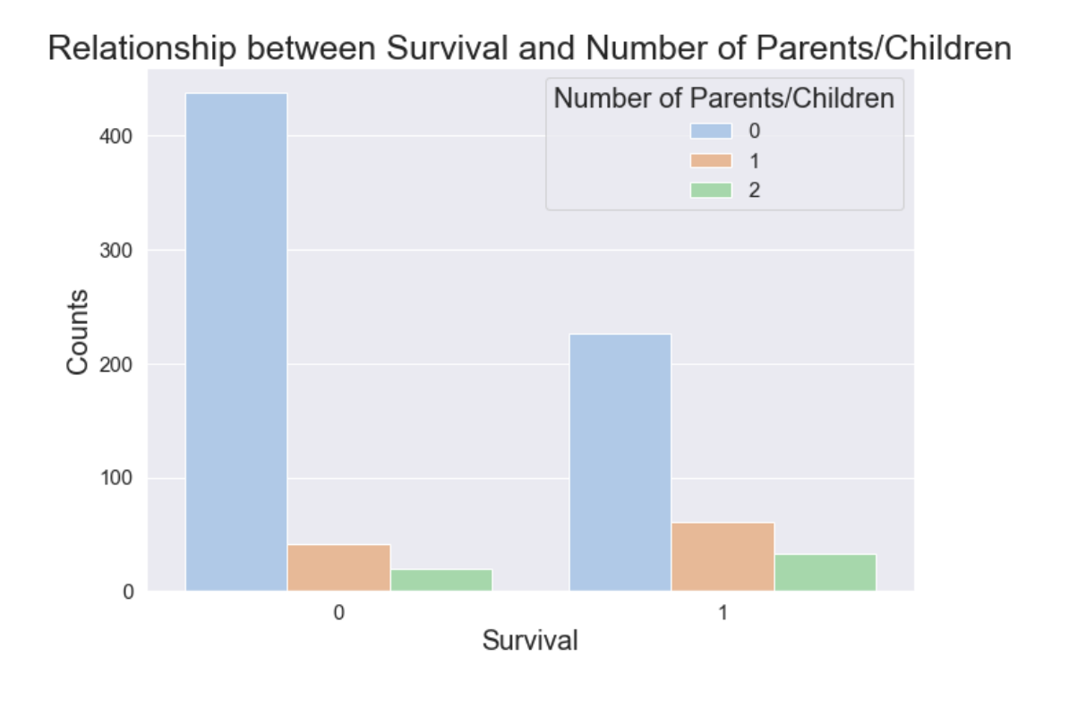
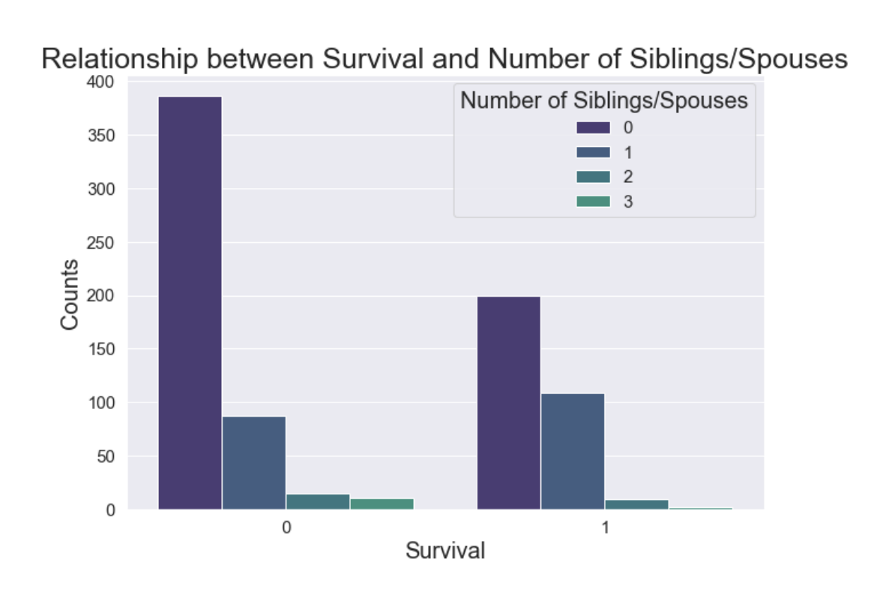
The grouped bar charts show that more people who did not travel with their families (spouses/siblings/ children/parents) did not survive.

Slide 14
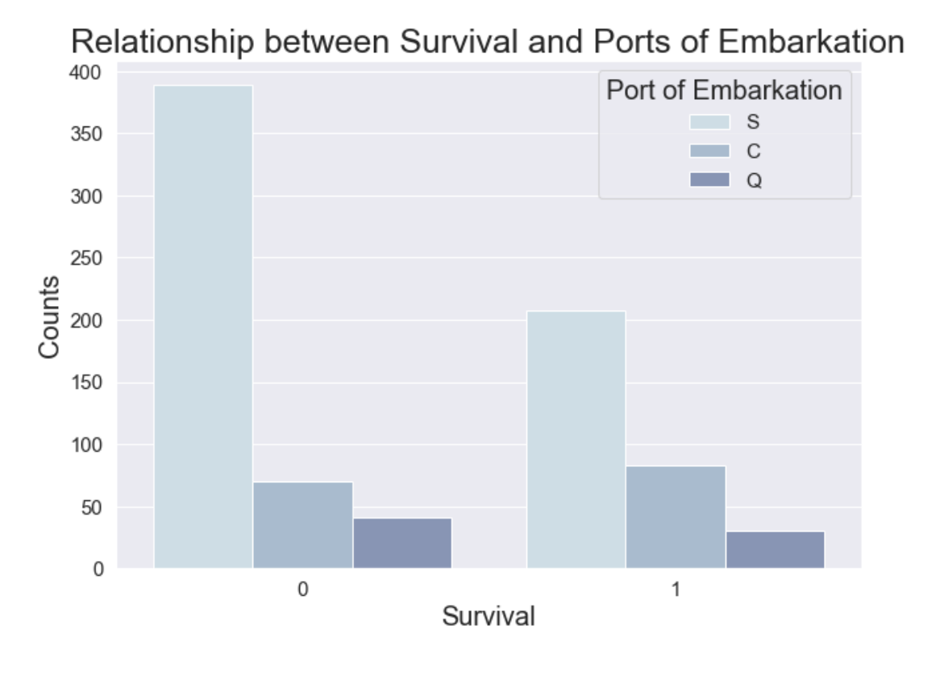
The grouped bar chart shows that more people who were travelling from Southampton did not survive.

Slide 15
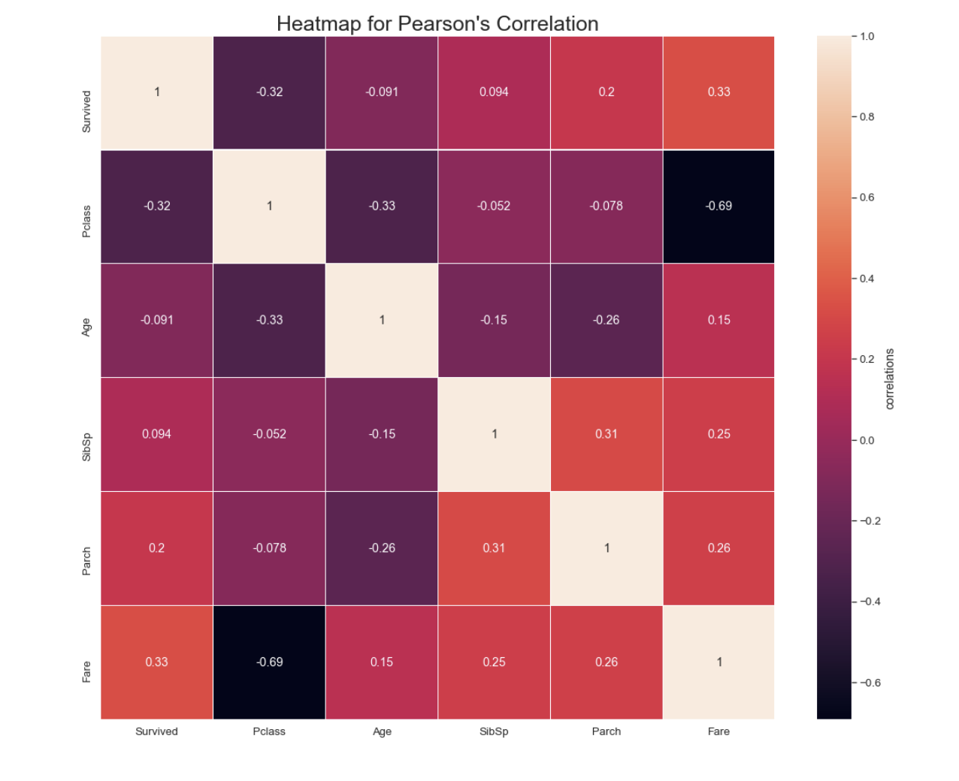
The highest positive correlation between different attributes is between survival ("Survived") and fare ("Fare") which is 0.33, and the highest negative correlation between different attributes is between the ticket class ("Pclass") and fare ("Fare") which is -0.69. Also, the relationship between survival ("Survived") and ticket class ("Pclass") is negative (-0.32). Therefore, the most important features include "Survived", "Pclass", and "Fare". These features are interesting because they explain the socioeconomic statuses of the passengers and their survival.

Slide 16
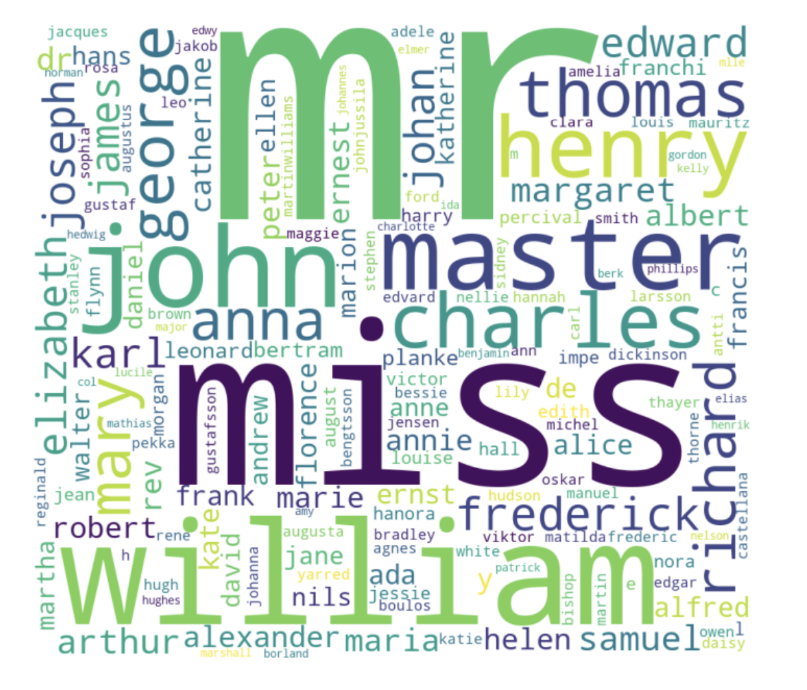
One way to extract information from non-numerical features is to create a word cloud as shown on the right (on the right is the word cloud for the names of the passengers). I found that "Mr" and "Miss" appeared frequently in the passengers' names. Another way is to create a bar chart as shown before (for example, I created a grouped bar chart to analyze the relationship between survival and gender).

Slide 17
Models
- The logistic regression algorithm tries to find a line that distinguishes between classes. It uses the sigmoid function to estimate the probabilities of being in a certain class, and it has a cost function that increases when the predictions are incorrect.
- The KNN (K Nearest Neighbors) algorithm assigns/predicts a label for a data point by analyzing the distances between the data point and its K nearest neighbors. Distance metrics must follow some rules like positivity to be considered as standards of measurement in the KNN algorithm.
- The SVM (Support Vector Machine) algorithm creates a decision boundary between classes by using hyperplanes. For non-linear data, SVM increases the dimensional space and uses kernel functions to get decision boundaries in higher-dimensional spaces.

Slide 18
Performance of the Models (Training and Test Sets)
Logistic Regression did a good job of predicting the survival of passengers. The F1-scores, accuracies, precisions, and recalls are pretty high which indicates that the model did well in predicting survival.
The K Nearest Neighbors did not do a good job of predicting the survival of passengers. I think the reason for this is because the distance metric used (Euclidean distance) might not be a great measure to classify the survival of the passengers. However, the F1-scores, accuracies, precisions, and recalls are pretty high which indicates that the model actually did well in predicting survival.
the Support Vector Machine algorithm did an okay job of predicting the survival of passengers. I think the reason for this is because the linear kernel might not be able to classify accurately. However, the F1-scores, accuracies, precisions, and recalls are pretty high which indicates that the model actually did well in predicting survival.

Slide 19
Performance of the Models with Hyperparameter Tuning (Training, Test, and Cross Validation Sets)
the performance of Logistic Regression did not change relative to the performance when the data was only split into training and test sets.
the Support Vector Machine algorithm seems to have improved in accuracy relative to the performance when the data was only split into training and test sets.
the K Nearest Neighbors algorithm seems to have improved in accuracy and precision relative to the performance when the data was only split into training and test sets.

Slide 20
Thank you!

